Slide 1


REFERENCE

Slide 2











Selected CLA Corporate Finance Transactions
2024
2024
2024
2024
2024
ACTHERM Distribuce s.r.o. Local heat distribution
Ski resort
Junior and senior financing facility
CZK 120 mil.
Junior and senior financing facility
CZK 120 mil.
Sale of company
Distributor of premium mattresses
Sale of real estate
Sale of company (Management Buy In) and Acquisition financing
Development of 198 apartments
Development of 198 apartments
Sold to
ČEZ Teplárenská, a.s.
Sold to
Sold to
External manager
Financing provided by private investors
2024
2024
2023
2023
2023
Energy / Power
balance services 9 MW
Energy / Power
balance services 6 MW
Energy / Power
balance services 6 MW
Energy / Power
balance services 9 MW in Slovakia
Energy / Power
balance services 9 MW in Slovakia
Junior refinancing facility
CZK 30 mil.
Junior refinancing facility
CZK 28 mil.
Junior refinancing facility
CZK 30 mil.
Junior financing facility
EUR 0.9 mil.
Junior financing facility
EUR 0.9 mil.
Financing
provided by
Financing
provided by
Financing
provided by
Financing
provided by
Energy / Development of
400 MWp photovoltaic power plant
Group of private investors
Group of private investors
Group of private investors

Slide 3










Selected CLA Corporate Finance Transactions
2023
2023
2023
2023
2022
Real estate – development of
4 houses
Energy / Power
balance services 9 MW
Energy / Power
balance services 9 MW
Real estate – development of
34 apartments
Water Filtration Systems
Junior and senior financing facility
CZK 10 + 20 mil.
Senior financing facility
CZK 92 mil
Junior financing facility of CZK 80 mil.
Junior and senior financing facility
CZK 140 mil.
Financial analysis, Independent Business Review, Business plan
Financing
provided by
Financing
provided by
Financing
provided by
Financing
provided by
Group of private investors
Private investor
2022
2022
2022
2022
2022
Shipping and Logistics / Technology
Electrical equipment / Complex measuring solutions
Healthcare products / Electronics
Cloud Services / Cyber Security / Data Center Technology
Machinery / Stainless steel products for Beer brewing & Chemistry industries
Sale of company
Acquisition of majority stake in the company
Sale of minority share
Cross-border
Business plan, Financial projections of IPCEI project of the company
Business plan, Financial projections and Valuation of the company
Sold to financial investor
Company acquired
Sold to German strategic investor

Slide 4

















Selected CLA Corporate Finance Transactions
2022
2022
2022
2021
2021
Jablo Glo s.r.o.
Food Production / Processed cheese producer
Joyrace a.s. &. Whalley a.s.
PROFIMIX SVIJANY s.r.o.
PLANMECA Finland
Sale of company
Chemical / Food & Pharmaceutical industry
Electronic Alarms
and security devices
Food industry / Mixes for bakeries
Healthcare / KaVo products
Acquisition of company
Sale of company
Acquisition of company
Acquisition of remaining share
Sold to financial investor
Sold to
Company acquired
Company acquired
Company acquired
TRON UP s.r.o.
Puratos Belgium
2021
2021
2021
2021
2021
Slovácká pekárna s.r.o.
Plastics industry / Packiging
Food Industry / Bakery
Logistics
Car dealer
Food industry / Chocolate products
Acquisition of company
Sale of company
Subsidiary of UK based logistics company GIST Ltd.
Sale of company
Acquisition of company
Acquisition of company
Company acquired
Sold to
Company acquired
Company acquired
Sold to
SENSA FOOD s.r.o.
PEK Group a.s.

Slide 5


















Selected CLA Corporate Finance Transactions
2021
2021
2021
2021
2021
Čermák a Hrachovec a.s.
Apple & ICT Reseller
Construction
Real-Estate portfolio
Real-Estate portfolio
Real-Estate portfolio
Acquisition of company
Acquisition of company & structured Financing
Acquisition of company
Acquisition of company
Acquisition of company
Company acquired
Company acquired
Company acquired
Company acquired
Airport Business Centre
Company acquired
Part of
Part of
2021
2021
2021
2021
2021
Telco and IT
Contruction & Development
Contruction & Development
Contruction & Development
Energy and heat distribution
Sale of company
Structured financing facility CZK 750 mil
The arrangement of the equity financing for the residential development of 21 apartments in Velká Úpa
The arrangement of the equity financing for the residential development of 40 apartments in Pec pod Sněžkou
The arrangement of the acquisition in the residential development in total volume of 2,9 mil. EUR
Sold to
Financing provided by

Slide 6















Selected CLA Corporate Finance Transactions
2021
2020
2020
2020
2020
Food Industry / Protein diet
Medical services
Fashion
IT services / Complex ICT infrastructure provider and integrator
ePayment solutions
Complex refinancing facility
Acquisition of company
Financing provided by the syndicate of
Complex Restructuring financial and legal Advisory
Sold to
J&T Thein SICAV a.s.
Research of potential development opportunities in CZ & SK
Company acquired
2020
2020
2020
2020
2020
Real-estate investment fund
Real-estate/ Offices
Food Production / Cereals, pasta, dried products
Car dealer
Dried Milk Producer
Sale of minority interest
Acquisition of
Real-estate company
Acquisition of company
Business plan, financial projections and restructuring plan
Acquisition of company
Sold to the existing principal investors
Company acquired
Company acquired
Principal Financing provided by
Company acquired
V5 Praha

Slide 7









Selected CLA Corporate Finance Transactions
2020
2020
2020
2020
2019
Commercial property
Food Production / Cereals, pasta, dried products
Telco and IT
Automotive industry 1st tier supplier
SPA / Medical services
Acquisition and structured Financing
Acquisition of company
Initial working capital Financing
Business plan, financial projections and restructuring plan
Strategic analysis of Business development scenarios
Real-estate financing provided by
Company acquired
Financing provided by
2019
2019
2019
2018
2018
SPA / Medical services
Food Production / Fresh mushrooms producer
Constructions
Trenchless technologies for repairs of water mains and sewer lines.
Electrical Engineering
Strategic analysis of Business development scenarios
Sale of company
Trenchless technologies for repairs of water mains and sewer lines.
Complex leveraged MBO advisory including acquistion financing
Producer of sophisticated tailor made electrical devices
Sold to
Sold to
Sold to
Sold to
GROUP of investors and managers

Slide 8












Selected CLA Corporate Finance Transactions
2018
2018
2018
2018
2018
Automotive industry 1st tier supplier
Food processing and deli production
Wholesaler of electro material
Food Production / Cereals, pasta, dried products
Food producer
Refinancing and new structured financing up to
CZK 570 mil
Complex leveraged MBO advisory including acquistion financin
Complex buy-side advisory
Acquisition of company
Acquisition of company
Financing was provided by
Acquisition financing provided by
Takeover of 100 % of shares
Company acquired
Company acquired
2018
2018
2017
2017
2017
Industrial property development
Investment company with focus on energy sector
Electronics
Agriculture
Real-estate/ Offices
Refinancing of the Equity up to CZK 1 billion
Financing of renewable energy power plant
Producer of various electronic devices
Acquisition of company
Acquisition of
Real-estate company
Real estate financing provided by
Structured project financing provided by
Sold to Shurter group
Company acquired
Company acquired
Park PDB

Slide 9













Selected CLA Corporate Finance Transactions
2017
2017
2017
2017
2017
Food production / Producer of frozen food
Food production / Food processing and distribution
Light industry
E - commerce
Engineering
Acquisition of company
Acquisition of company
Automotive industry 1st tier supplier
Sale of industrial property
Sale of company
Engineering company in the area of nuclear power
Company acquired
Company acquired
Sold to WMS Group
Sold to Czech News Center
Sold to strategic investor
2017
2017
2016
2016
2016
Engineering
Industrial automation
Investment holding
Industrial property Development
Engineering
E&I Contractor in ME Energy Sector
Developer and producer of robotic machines and equipments
Producer of air ventilation equipment and welded steel constructions
Financing of the industrial property
Industrial property Development
Sold to Ghobash
Sold to Tarpan Group
Company acquired
Real estate financing provided by
Acquisition of the industrial property

Slide 10













Selected CLA Corporate Finance Transactions
2016
2016
2016
2016
2016
Renewable Energy
State-of-the-art health facility
Elderly care facility
Software solution
Light-industry and logistics
Renegotiation, restructuring of current financing
Acquisition and financing of the Property
Fundraising for software solution
Sale mandate for fully occupied industrial property
Acquisition of photovoltaic power stations with total output 1,53 MW
Financing provided by
Real estate financing provided by
Seed funding provided by
Sold to Arete Invest
Acquisition by
2015
2015
2015
2015
2015
Producer of special and all-purpose containers and carriers
Light-industry and logistics
Light-industry and logistics
Light-industry and logistics
Refinancing of the industrial property
Acquisition bridge financing for the acquisition of Emerge
VGD-AVOS (Slovakia)
Audit, Tax Advisory, Accounting, Payroll
Consulting of sale engineering company in the automotive segment
Acquisition bridge financing for the acquisition of Emerge
Real estate financing provided by
Provided by
Acquisition of RECTE (SK)
Consulting of exit strategy
Acquisition of EMERGE

Slide 11












Selected CLA Corporate Finance Transactions
2015
2015
2015
2015
2015
2015
Industrial property Development
Heavy industry
Digital media
Leading Law firm in the Czech Republic and Slovakia
Digital media
Industrial property Development
Refinancing and new financing of the industrial property
Acquisition of Assets of the company Excon Steel within the insolvency process
Market leader in on-line performance marketing
Installation of electric wiring/
measuring and regulation
Market leader in on-line performance marketing
Valuation of HHP Group in the Czech Republic and Slovakia
Financing of two additional warehouses and Refinancing
Acquisition of EXCON STEEL
Valuation of selected Construction Company
Sale to PUBLICIS Group
Sale to PUBLICIS Group
2014
2014
2014
2014
2014
Transformace reality
Pytloun Hotel Group
Acquisition of Hotel Orfeus from the insurance company of Ministry of home affairs
Recycling, processing and manufacturing products made of precious metals
Major publishing house in Slovakia (newspaper, magazines and digital media)
Food production/ distribution,
canteen and catering
with regional coverage
Acquisition of Hotel Silent
in Krkonose mountains, Harrachov
Sale to RENOVA GROUP
Sale to 3V Media (NL)
Real Estate Financing provided by
Sale to KMC Catering
Real Estate Financing provided by

Slide 12













Selected CLA Corporate Finance Transactions
2014
2014
2014
2014
2014
R.I. REALINVEST
Special Financial Services
Logistic facility Park Kosmonosy
Real Estate Development
Pytloun Hotel Group
Insurance of bank deposits as part of the Czech banking system
Real Estate Development
Traditional publishing house
Division Medical Services
Sale to
Acquisition of Grand Hotel Imperial in Liberec
Debt structuring and raising advisory
Real Estate Financing provided by
Financial analysis, business plan and valuation
Structured Real Estate Leasing Financing provided by
Real Estate Financing provided by
2014
2014
2014
2014
2014
Lumen Energy
Regional hospital center
Regional hospital center
Local energy distribution networks (CR)
Distributor and dealer of electro-material
Merger with Nemocnice
Turnov s.r.o. and valuation
of stakes swapped
Distributor and dealer of electro-material
Divestment of 100% stake
in Česká sanita, s.r.o.
Sale of 66% Stake to E.ON
Acquisition of electro-material distributor Dabok s.r.o. CZ
Acquisition of 80% interest in distributor of electro-material ELRON s.r.o. (Slovakia)

Slide 13










Selected CLA Corporate Finance Transactions
2013
2013
2013
2013
2013
Electronic Alarms
and security devices
Apollon Property, uzavřený investiční fond,a.s.
Investment holding
AUREOLE GROUP s.r.o.
City Congress s.r.o.
FARGUELL NITRA, s.r.o.
Assistance in several acquisitions in the field of central security systems
Acquisition of a residential portfolio
High class restaurants/
Luxury congress center
Metal stamping for automotive and electronics industry
Acquisition of key assets and technology from CUTCO STEEL
Real Estate Financing
Restructuring, business plan, company valuation, financial advisory
Independent Business Review for the company banking house
2013
2013
2013
2013
2013
Major Slovak publishing house
LUMEN DISTRIBUCE s.r.o.
D+D Park Pardubice, a.s.
MAGNA EA
PENTO spol. s r.o.
Newspaper, magazines and Digital media
Local energy distribution network s (CR)
Real estate refinancing
Electricity and Gas Trader SK
Chemical and petrochemical engineering and design
Acquisition of Centrum.sk from the investment fund Warburg Pincus
Sale of 33% stake to E.ON Trend and Potyla
Logistics facility
Zelená Louka Pardubice
Support in a potential strategic partnership the German Gas distributor VNG
Spin-off of several non-core business units

Slide 14










Selected CLA Corporate Finance Transactions
2013
2013
2013
2012
2012
Jablotron
D+D Park Pardubice, a.s.
Vendys , s.r.o.
LUMEN DISTRIBUČNÍ, s.r.o.
Mladá fronta, a.s.
Electronic Alarms
and security devices
Logistics facility
Park Kosmonosy - Phase I
Petrochemical products trading and petrol distribution, hotels
Traditional publishing house
Several acquisitions of central security operators
Structured real estate finance
Balance sheet restructuring and refinancing
Acquisition of the leading economical magazine Euro
Acquisition from CTP
2012
2012
2011
2011
2011
Rudná Development, s.r.o.
Real estate development
Lumen International
MANAG, a.s.
Jablotron
Prime restaurants and catering services
Na Malé Růži – Drahelčice
Residential Project Phase I
Electro installation/
Power distribution
Electrical equipment and wiring, electro technical engineering
Electronics/ Security
Structured real estate finance
Entry of a Strategic partner
Sale of a majority interest
to ARX Equity Partners
Acquisition of a leading security agency
ERFLEX a.s.

Slide 15











Selected CLA Corporate Finance Transactions
2011
2011
2010
2010
2010
D+D Park Pardubice, a.s.
Retail and administrative facilities in Vrchlabí
Financial investor
Alba
Real estate development
Refinancing and acquisition finance
Acquisition of internet and magazine activities
Computer Press Media
Project office/Project design
and Engineering
Recycling/Waste processing
Real estate financing provided by
Structured Project Finance provided by
Acquisition of majority interest
in PRODEX (Slovakia)
Sale of a majority interest
Buyer J&T Group
2010
2010
2010
2010
2010
Spolek pro chemickou
a hutní výrobu, a.s.
Road Traffic Systems
Bioproject
A.P. Moeller-MAERSK Group
JIP Papírny Vetřní
Buy-out of 50% share in ELTODO Dopravní Systémy
Chemicals
Bio-Gas station works
Research and acquisition support in the area of CEE
Paper producer
Project finance structuring
Feasibility study and Valuation with regard to
Strategic/ Equity partner
Sale of majority interest
to a financial investor
Sale of Water Cleaning Facilities (JIP-COV)

Slide 16













Selected CLA Corporate Finance Transactions
2010
2009
2009
2008
2009 / 2008
C.S. Cargo a.s.
Vienna Capital Partners
AZET.SK
Transportation and
Logistics provider
Financial investor
Luxury goods/ Fashion
Acquisition of TSL Unitrans Ltd. (Poland)
Support in series of internet
related acquisitions,
and valuation of targets
Acquisition of Golem
Acquisition of internet travel portal Orbion.cz
Sale of Hugo Boss/ Prague Airport shops
2008
2008
2008
2008
2007
Acquisition of
HEXION Speciality Chemicals
(US, Germany)
C.S. Cargo Holding, N.V.
Meopta Přerov
Společnost 7PLUS, s.r.o
C.S. Cargo Holding, N.V.
Acquisition of the transportation
& logistic company
JTC Transcentrum
Leading publishing house
in Slovakia
Transportation and logistics
provider
Spolek pro chemickou
a hutní výrobu, a.s.
Merger, restructuring, due diligence, audit
Financial advisory, company valuation, business plan
Acquisition of the transportation & logistic company mGal Spedition, s.r.o. (Slovakia)

Slide 17





Selected CLA Corporate Finance Transactions
2007
2007
2007
2007
C.S. Cargo Holding, N.V.
TRIFID International N.V.
Cobra s.r.o.
Poštová banka, a.s. (Slovensko)
Transportation and logistics provider
Owner of the logistic group
Financial investor
Rating Advisory Services for rating assessment performed by Moody‘s Investors Service
Acquisition the transportation & logistic company
Smidbersky Transport, a.s.
Structured Sale of 30% Share to UNICREDIT Merchant Banking
(Pre-IPO Investment

Slide 18
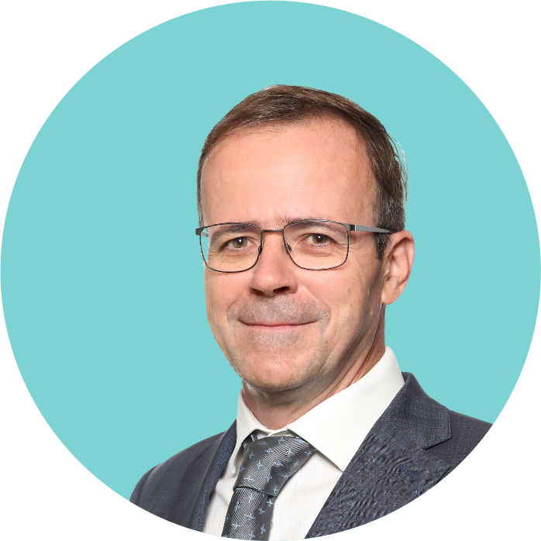
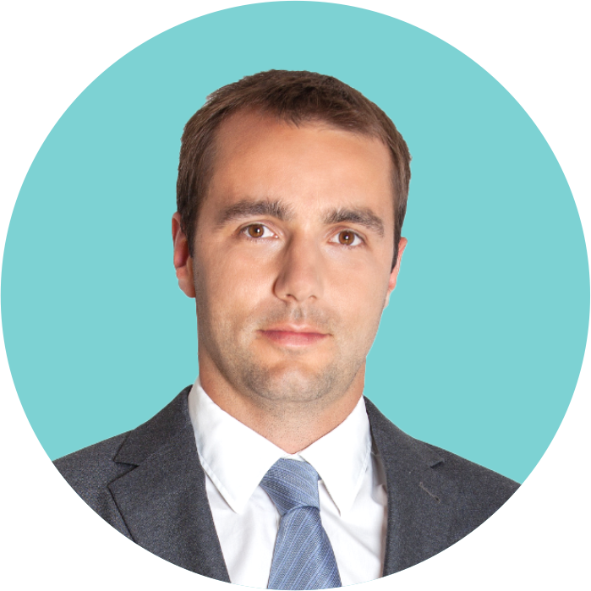
Contacts
Filip OTRUBA
Partner CLA Corporate Finance
T: +420 241 015 111
M: +420 602 247 318
E: filip.otruba@claczech.cz
Jan STRÁNSKÝ
Partner CLA Corporate Finance
T: +420 241 015 111
M: +420 777 026 316
E: jan.stransky@claczech.cz
CLA Czech Republic is a trade name under which multiple business entities provide advisory services in the Czech Republic. For further information, please visit www.claczech.cz/disclaimer. CLA Czech Republic is an independent member of the CLA Global international network. For further information, please visit www.CLAglobal.com/disclaimer.

Slide 19
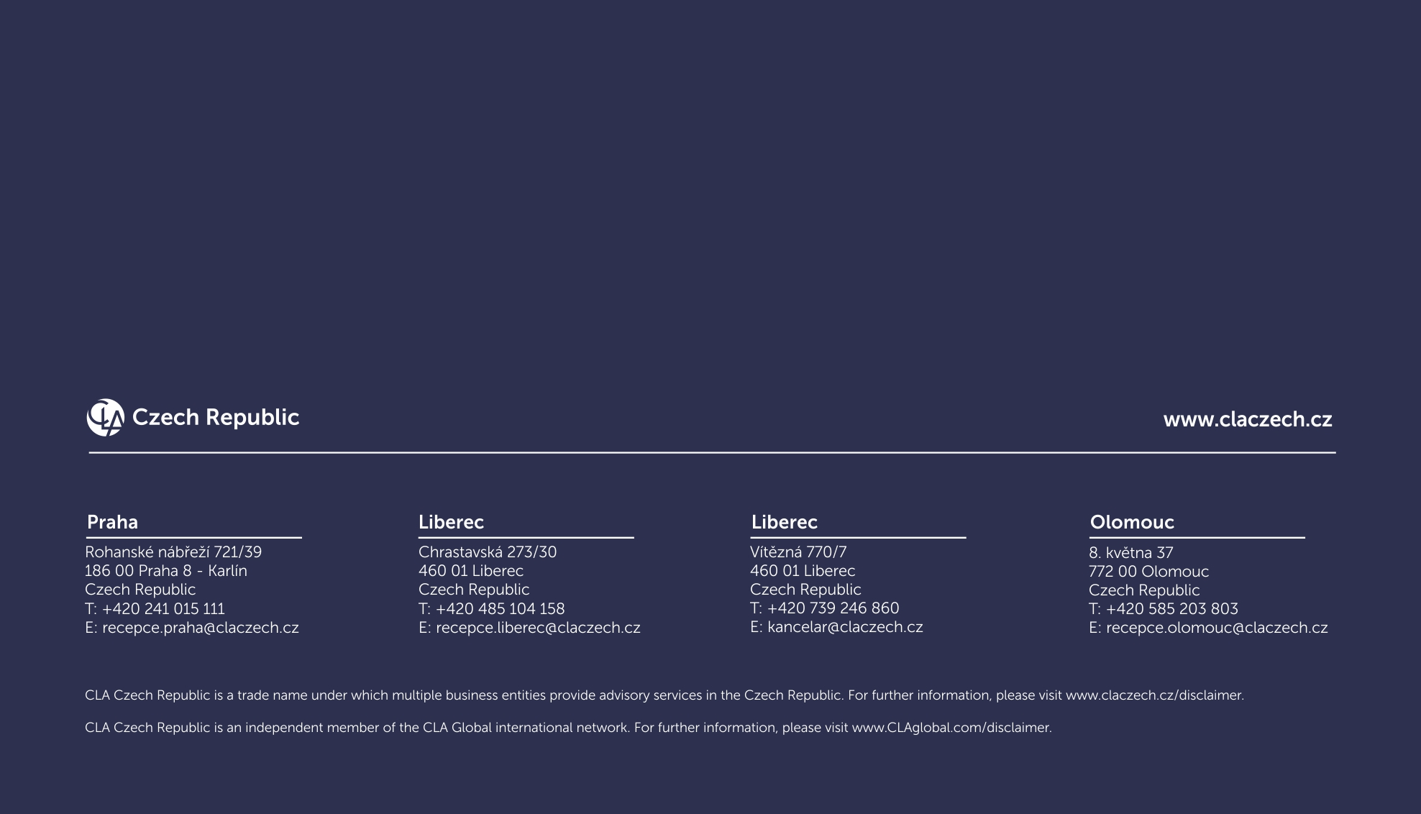
Filip OTRUBA
Partner CLA Corporate Finance
T: +420 241 015 111
M: +420 602 247 318
E: filip.otruba@claczech.cz
Jan STRÁNSKÝ
Partner CLA Corporate Finance
T: +420 241 015 111
M: +420 777 026 316
E: jan.stransky@claczech.cz
CLA Czech Republic is a trade name under which multiple business entities provide advisory services in the Czech Republic. For further information, please visit www.claczech.cz/disclaimer. CLA Czech Republic is an independent member of the CLA Global international network. For further information, please visit www.CLAglobal.com/disclaimer.

